Slide 1

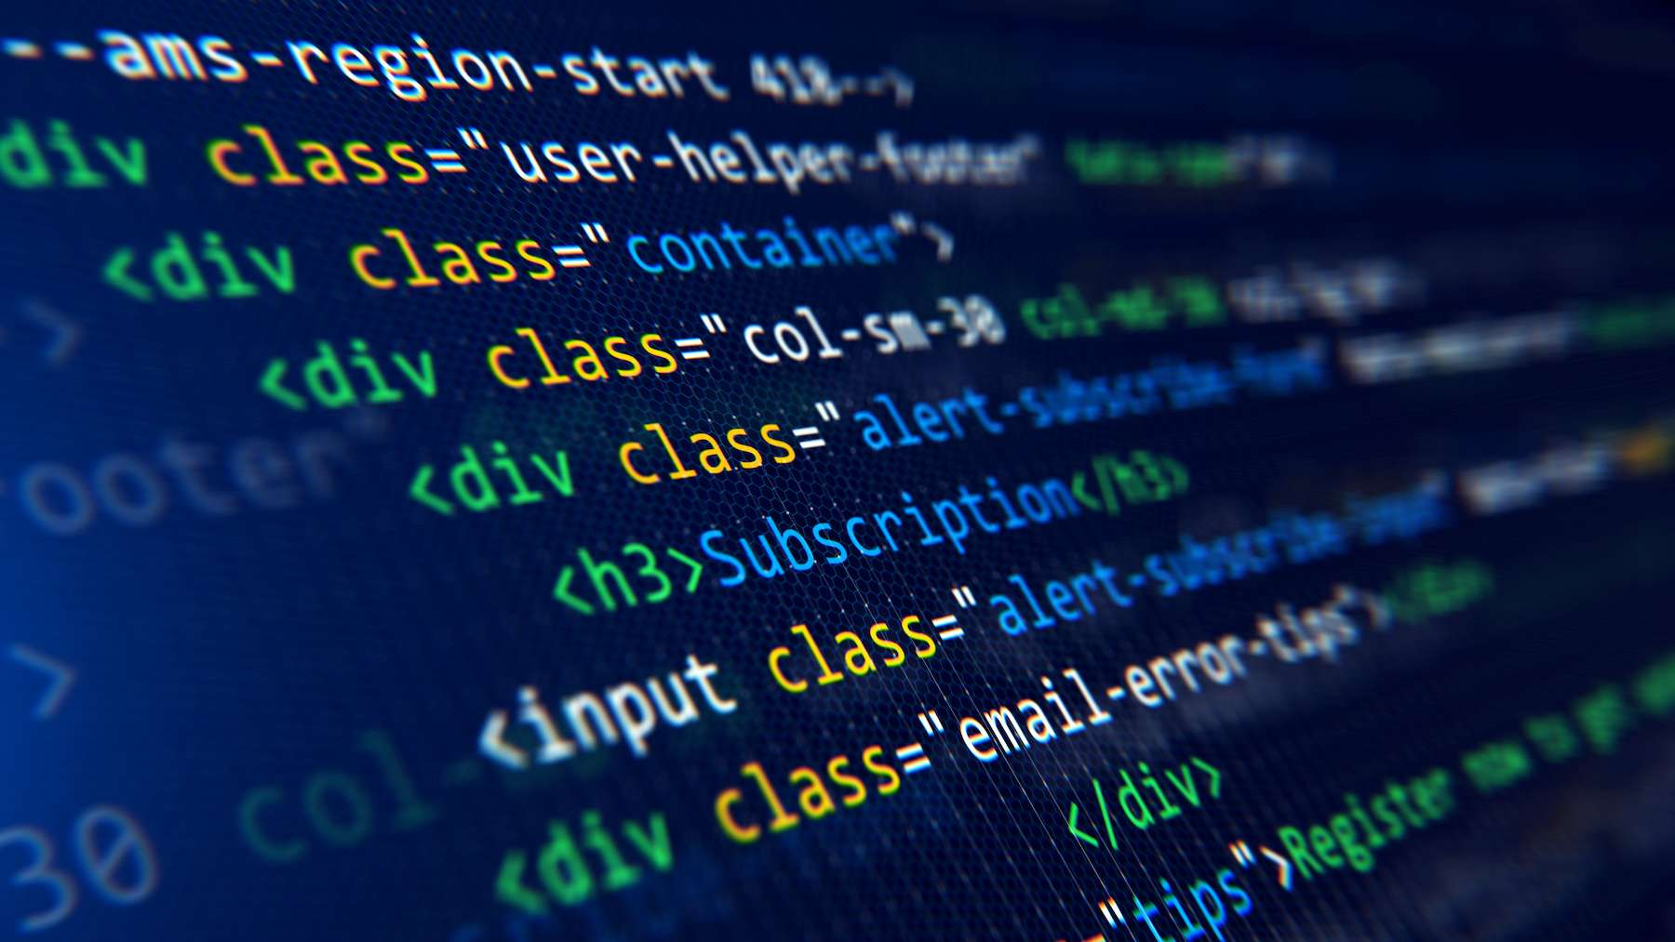
￼
WEB DEVELOPMENT WORKSHOP

Slide 2

Workshop Plan
DAY
DAY
DAY
01
01
02
Intro
HTML
CSS
DAY
DAY
DAY
03
04
05
Javascript
First Project
Second Project

Slide 3





GOALS AND OBJECTIVES
throughout this week we will learn the web development :
04
Final Project: Build a Twitter login page using HTML, CSS, and JavaScript.
03
JavaScript Basics: Learn to add interactivity to web pages.
02
CSS Fundamentals: Learn to style web pages with colors, fonts, and layouts.
01
HTML Essentials: Learn to structure web content with HTML.

Slide 4



Next Workshop (maybe)
We're considering a React workshop next! But mastering the fundamentals of HTML, CSS, and JavaScript is essential to succeed with React. Strong basics make learning advanced frameworks much easier.
a lot of practice
React builds upon the core web technologies. Solidify your HTML, CSS, and JavaScript skills now to prepare for a potential deep dive into React.

Slide 5






Why Learn Web Development?
High Earning Potential
Web developers are in high demand, and that translates to competitive salaries. The potential to earn a good living is a significant motivator.
In-Demand Skills
Web development skills are highly sought after in today's job market. You'll be well-equipped for a variety of roles in the tech industry.
Future-Proof Career
The need for websites and web applications isn't going away. Learning web development is a solid investment in your future. Every company needs a website.

Slide 6



What do you need to know?
Absolutely nothing!
This workshop is designed for complete beginners. We'll start from the very basics, so don't worry if you've never written a line of code before. Just bring your enthusiasm and willingness to learn!

Slide 7
What are the tools you Need?
Prettirer
Live Server
A code formatter that automatically formats your code to make it clean, consistent, and easy to read.
A simple development server that automatically reloads your web page in the browser whenever you make changes to your code.
Chrome
A web browser for testing and viewing your web pages. While other browsers work, Chrome has excellent developer tools.
Visual Studio Code
A powerful and popular code editor with built-in support for HTML, CSS, and JavaScript. It's beginner-friendly and has a large extension library (including Prettier and Live Server).

